Slide 1
Module 2:Creating SharePoint Websites

Slide 2
Module 2
Creating SharePoint Websites
What is Web Application.
Sites and Site Collection
Design an information architecture strategy.
Select the correct template for your website.
Organize site collections!
Build logical navigation.
Work with site templates.
Apply style and branding to your site!
Administering site settings
SharePoint Designer

Slide 3
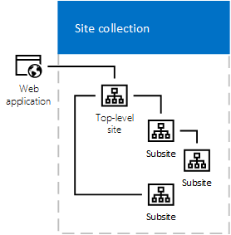
Web Application
Web Application Components
Web Application Services
Notes:
Web Application Components
A SharePoint web application has the following components:
An IIS web site that hosts the web application and handles the incoming requests from clients.
A web.config file that stores the configuration settings for the web application, such as authentication, authorization, and web part settings.
A content database that stores the site collections, sites, lists, libraries, and items that belong to the web application.
A service application proxy group that associates the web application with a set of service applications that provide additional functionality, such as search, user profiles, managed metadata, and business data connectivity.
A web application policy that defines the permissions and roles for users and groups at the web application level.
A web application feature that enables or disables specific functionality for the web application, such as workflows, site templates, and site columns.
Web Application Services
A SharePoint web application relies on the following services to provide the core functionality and features:
The SharePoint Foundation Web Application service that runs on each web server in the farm and processes the requests from the IIS web site.
The SharePoint Timer service that runs on each server in the farm and executes scheduled tasks, such as backups, alerts, and workflows.
The SharePoint Administration service that runs on each server in the farm and manages the configuration and deployment of the web applications.
The SharePoint Search service that crawls and indexes the content and metadata of the web applications and provides the search functionality.

Slide 4
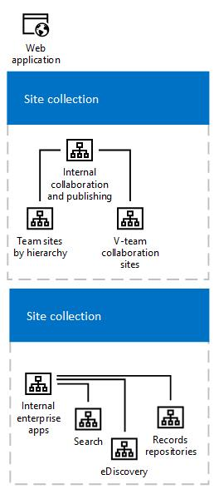
Sites and Site Collection
A site collection is made up of one top-level site and all sites below. The number of site collections you can have in a single web application depends on the capacity of your server infrastructure.
Notes:
https://learn.microsoft.com/en-us/sharepoint/sites/plan-sites-and-site-collections

Slide 5
Design an information architecture strategy.
Understanding the business goals and user needs
Defining the site hierarchy and navigation
Creating and applying content types and metadata
Implementing search and discovery features
Evaluating and refining the IA strategy
Notes:
Designing an Information Architecture Strategy for SharePoint 2019
A guide for SharePoint administrators and architects
Introduction
Information architecture (IA) is the process of organizing, structuring, and labeling the content and data in SharePoint sites and collections. A good IA strategy helps users to find, access, and use the information they need efficiently and effectively. It also supports the governance, security, and compliance of the SharePoint environment.
This document provides an overview of the key steps and considerations for designing an IA strategy for SharePoint 2019. It covers the following topics:
Understanding the business goals and user needs
Defining the site hierarchy and navigation
Creating and applying content types and metadata
Implementing search and discovery features
Evaluating and refining the IA strategy
Understanding the business goals and user needs
The first step in designing an IA strategy is to understand the business goals and user needs of the SharePoint 2019 environment. This involves conducting a stakeholder analysis, a user research, and a content audit.
A stakeholder analysis identifies the key roles and responsibilities of the people who own, manage, and use the SharePoint sites and collections. It helps to clarify the vision, scope, and objectives of the IA strategy, as well as the expectations, requirements, and constraints of the stakeholders.
A user research gathers information about the characteristics, behaviors, and preferences of the end users of the SharePoint sites and collections. It helps to understand the user personas, scenarios, tasks, and pain points, as well as the user feedback and satisfaction.
A content audit evaluates the current state of the content and data in the SharePoint sites and collections. It helps to identify the content types, formats, sources, owners, lifecycles, and quality of the content, as well as the content gaps and redundancies.
Defining the site hierarchy and navigation
The second step in designing an IA strategy is to define the site hierarchy and navigation for the SharePoint 2019 environment. This involves creating a site map, a site structure, and a navigation scheme.
A site map is a visual representation of the logical relationship and grouping of the SharePoint sites and collections. It helps to organize the content and data into meaningful and coherent categories and subcategories, as well as to establish the scope and boundaries of the IA strategy.
A site structure is a physical arrangement of the SharePoint sites and collections in the SharePoint farm. It helps to determine the site templates, features, permissions, and policies for each site and collection, as well as to optimize the performance, scalability, and manageability of the SharePoint environment.
A navigation scheme is a set of tools and methods that enable users to move around and access the content and data in the SharePoint sites and collections. It helps to provide consistent, intuitive, and user-friendly navigation elements, such as menus, links, breadcrumbs, and sitemaps, as well as to support the user tasks and scenarios.
Creating and applying content types and metadata
The third step in designing an IA strategy is to create and apply content types and metadata for the SharePoint 2019 environment. This involves defining the content types, the metadata fields, and the term sets.
A content type is a reusable collection of settings and attributes that describe a specific type of content or data in SharePoint. It helps to standardize the structure, format, and behavior of the content, as well as to enable the content management and reuse.
A metadata field is a property or a tag that describes an aspect or a characteristic of a content or data item in SharePoint. It helps to classify, organize, and filter the content, as well as to enhance the search and discovery features.
A term set is a hierarchical collection of terms or keywords that represent a specific domain or vocabulary in SharePoint. It helps to create and manage a consistent and controlled metadata taxonomy, as well as to support the content types and the navigation scheme.
Implementing search and discovery features
The fourth step in designing an IA strategy is to implement the search and discovery features for the SharePoint 2019 environment. This involves configuring the search settings, the search components, and the search results.
The search settings are the parameters and options that define the scope, behavior, and appearance of the search functionality in SharePoint. They help to specify the search sources, the search queries, the search scopes, and the search web parts, as well as to customize the search experience.
The search components are the services and processes that enable the search functionality in SharePoint. They help to crawl, index, analyze, and rank the content and data in the SharePoint sites and collections, as well as to provide the search results.
The search results are the outputs and outcomes of the search functionality in SharePoint. They help to display the relevant and useful content and data items that match the user queries, as well as to provide the refinement and filtering options.
Evaluating and refining the IA strategy
The fifth and final step in designing an IA strategy is to evaluate and refine the IA strategy for the SharePoint 2019 environment. This involves conducting a usability testing, a user feedback, and a content review.
A usability testing is a method of measuring and assessing the effectiveness, efficiency, and satisfaction of the IA strategy in SharePoint. It helps to test the IA strategy with real users, tasks, and scenarios, as well as to collect and analyze the quantitative and qualitative data.
A user feedback is a method of gathering and understanding the opinions and suggestions of the users regarding the IA strategy in SharePoint. It helps to solicit and listen to the user comments, ratings, and reviews, as well as to identify the user needs and expectations.
A content review is a method of evaluating and improving the quality and relevance of the content and data in SharePoint. It helps to audit and update the content types, the metadata fields, and the term sets, as well as to eliminate the content gaps and redundancies.

Slide 6
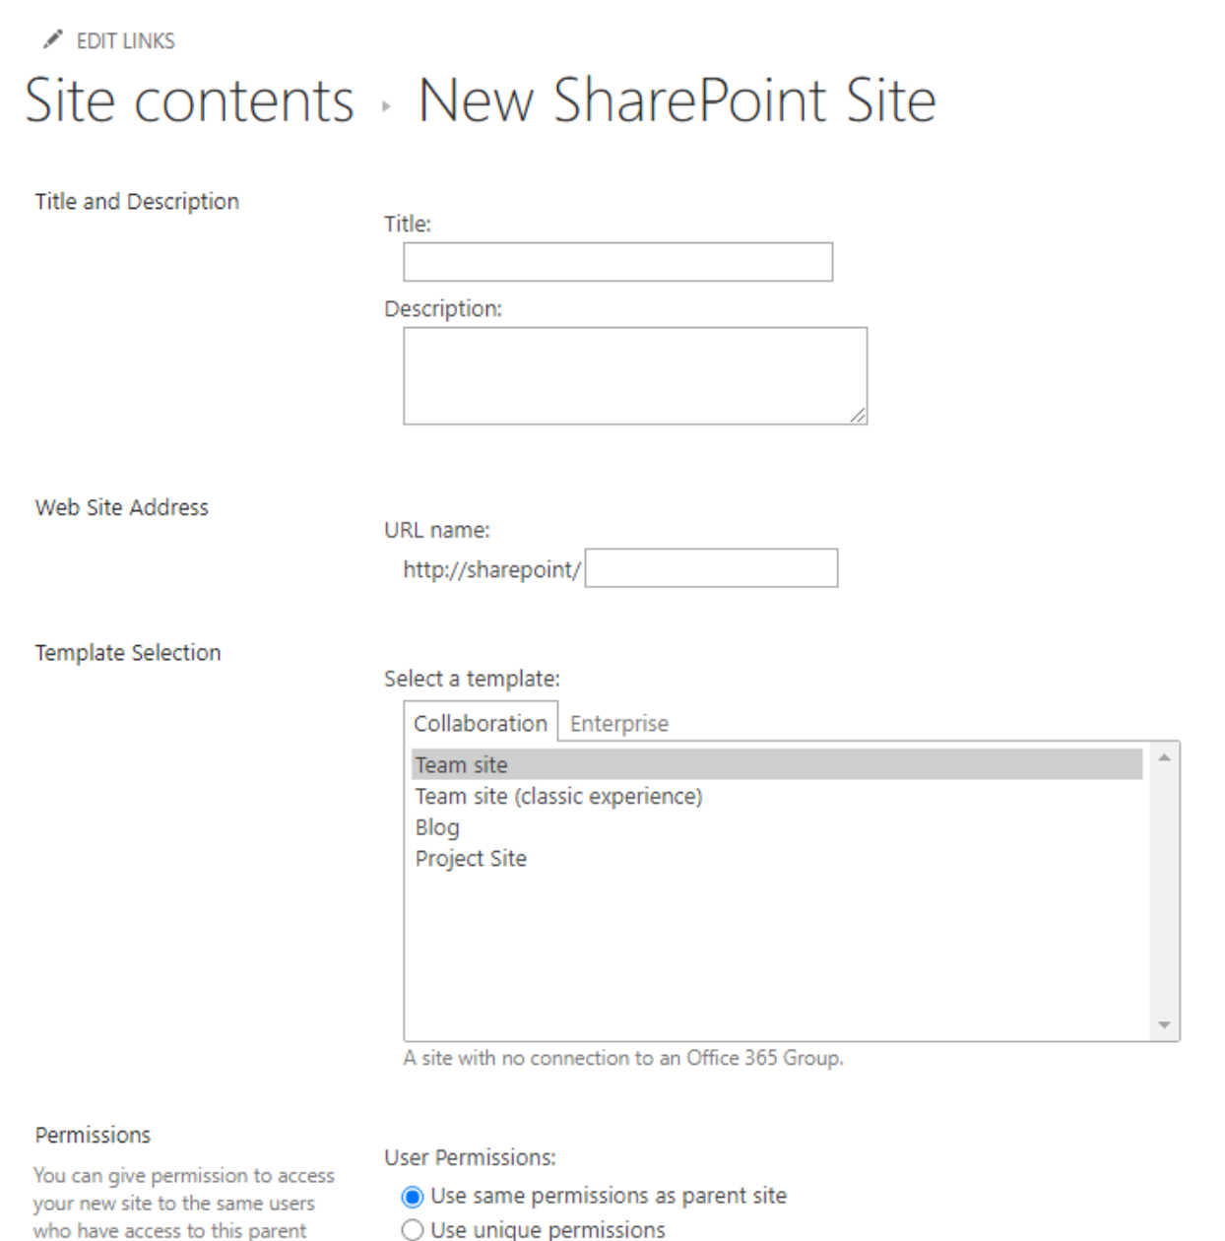
SharePoint Templates
SharePoint templates are pre-configured sites or lists that you can use to create new sites or lists with the same settings, features, and content. Templates can help you save time and ensure consistency across your SharePoint environment.

Slide 7
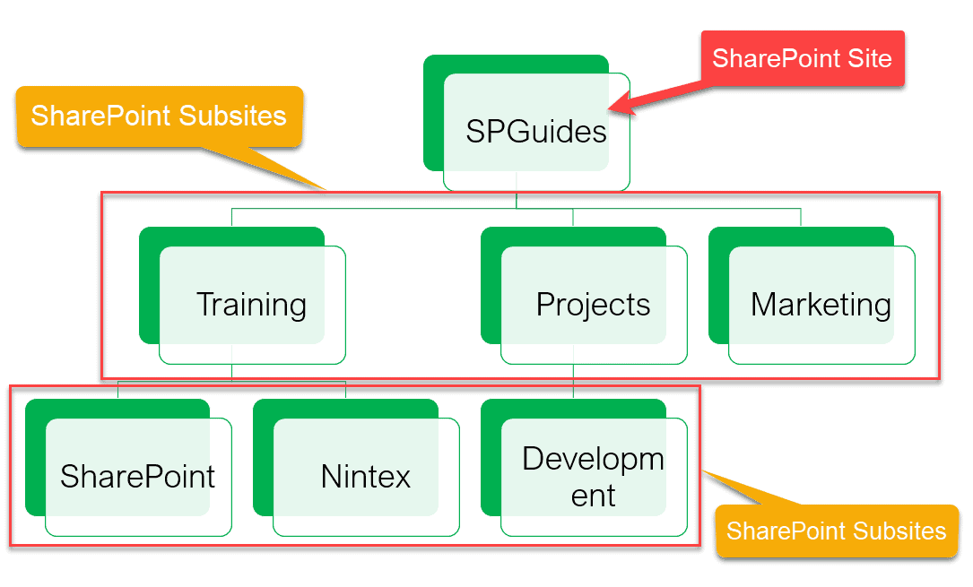
Organize site collections!

Slide 8
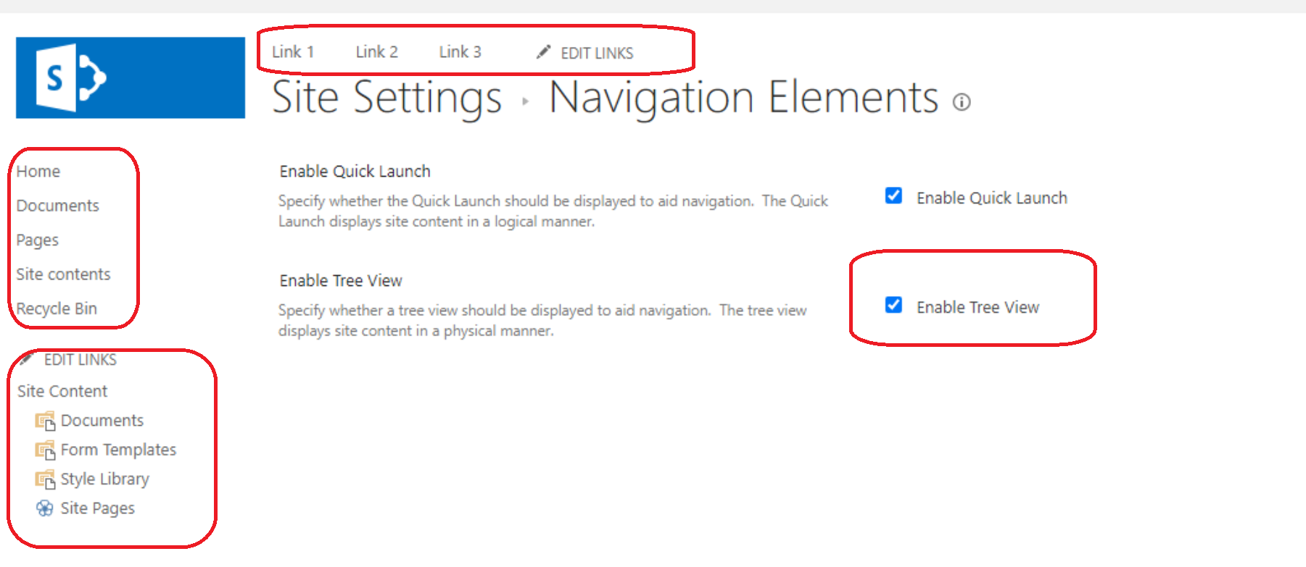
Navigation.
Managed Navigation
Top Link Bar
Quick Launch
Tree view
Metadata navigation
Notes:
Site navigation are the sets of controls and links in your site collections, sites and pages that help orient users to where they are and help them easily get to other relevant locations. For example, you can configure site navigation to help users get to other sites in the site collection or you can configure it so that the top navigation and the vertical navigation controls are dynamically generated based on context of what the user is looking at. A well planned site navigation strategy make SharePoint Server sites easier to use.
SharePoint Server has many features that use search technology to provide site owners with ways to display content dynamically on web pages.
Managed Navigation - When you use managed navigation, you create a term set that represents the navigation hierarchy, and navigation controls display data from the term set. You can change the navigation hierarchy by changing the term set. For more information, see Overview of managed navigation in SharePoint Server. Managed navigation is disabled by default in all site templates except the Publishing Portal site collection template.
Navigation links are subject to security trimming. This means that if a site user does not have permissions to the destination SharePoint Server site or page of the link, then that link is not displayed. Pages, sites, and links that are manually added to navigation can be configured to be available only to members of a particular audience. Users who are not members of that audience cannot see links to sites and pages that are targeted to that audience.
Top Link Bar
The Top link bar control displays links to the sites that are one level below the current site in a site hierarchy. It is common for the top link bar to appear at the top of each page in a site. By default, all sites that are one level below the current site are added to the top navigation, and each site has its own unique top navigation. Site owners can customize the top navigation for a specific site.
Site owners can choose to inherit the top navigation from the parent site. This approach allows users to switch from one site to another from anywhere within the site collection, by allowing the top navigation to stay the same in all the sites in the site collection. For example, an Internet site that is used to market an organization's products could have a site for each line of its products. By displaying each product's site in the top navigation of each site, site designers can make it possible for users to easily switch from one site to another without having to return to the site home page.
Other top navigation configuration features include the following:
Linking to the web pages of all the top-level sites in SharePoint Server only
Linking to specified external sites
Linking to specified sites or pages that are anywhere in the site.
Organizing links under headings in SharePoint Server only.
Manually sorting the items on the top link bar
Restricting the maximum number of items to show at the global navigation level in SharePoint Server only
All top link bar features, such as linking to external sites, can be defined uniquely for each site. If you are on a top level site, you can add, move or rearrange the links by clicking EDIT LINKS
By using Design Manager you can additionally customize the appearance and functionality of the top link bar in SharePoint Server only.
Quick Launch
Quick launch typically highlights the important content in the current site, such as lists and libraries. It is common for it to appear on the left of each page in a site.
Quick launch configuration features include the following:
Linking to sites that are on the same level of the site hierarchy as the current site in SharePoint Server only
Linking to specific external sites or to pages in the current site
Organizing links under headings.
Manually sorting the items in Quick Launch
Restricting the maximum number of items to show at the navigation level in SharePoint Server only
If you want to add, remove, or rearrange the links, click EDIT LINKS in the vertical navigation. You can also add, remove, rearrange links or create new headings in Site Settings for the site. To enable or disable Quick Launch, click the gear icon in the upper-right corner and then click Site Settings. In the Look and Feel area, click Tree view, and then select the Enable Quick Launch check box.
Just as you customize top navigation, you can also customize the appearance and functionality of vertical navigation by using Design Manager in SharePoint Server.
Tree view
Tree view appears on the left side of the page. If you have enabled Quick launch and Tree view, Tree view will appear below Quick launch. Tree view displays site content, such as lists, libraries, and sites that are in the current site, in a hierarchical structure.
By default, tree view navigation is turned off. To enable tree view, click the gear icon in the upper-right corner and then click Site Settings. In the Look and Feel area, click Tree view, and then select the Enable Tree View check box.
Metadata navigation
Metadata navigation displays metadata about library and list content in the tree view navigation, and lets users filter library or list content based on specified fields. Site administrators can configure metadata navigation by using the Metadata Navigation Settings page for a list or library to configure the navigation hierarchies and key filters that are available to users. Metadata navigation is displayed only when a user views the list or library for which metadata navigation was configured.
Managed navigation
Managed navigation enables you to define and maintain the navigation on your site by using term sets. This method supplements the existing SharePoint navigation based on site structure. You create the managed navigation structure by adding terms to the navigation term set in the Term Store Management tool. You can copy the navigation term set and translate it into the same languages that are used for variations labels.

Slide 9
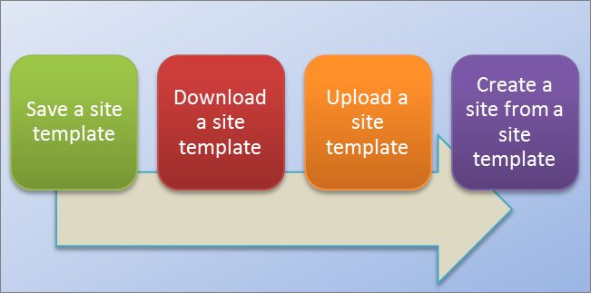
Work with site templates.
After you have customized your SharePoint site so that it contains the libraries, lists, views, workflows, logos, and other elements that you require for your business, you may want to create a template of that site for reuse. A site template is like a blueprint for a site. Creating a site template allows you to capture your customizations, so that they can be quickly applied to other SharePoint environments and even use the template as the basis for a business solution. Users can create new sites based on the template or you can hand it off for additional development in Visual Studio.
Notes:
Create and use site templates in SharePoint Server versions
Note: Moving site templates between different versions, such as SharePoint 2010 to SharePoint 2013, is not supported. Moving between SharePoint Servers 2013, 2016, and 2019 should work, though you may need to check the template to ensure it's complete.
After you have customized your SharePoint site so that it contains the libraries, lists, views, workflows, logos, and other elements that you require for your business, you may want to create a template of that site for reuse. A site template is like a blueprint for a site. Creating a site template allows you to capture your customizations, so that they can be quickly applied to other SharePoint environments and even use the template as the basis for a business solution. Users can create new sites based on the template or you can hand it off for additional development in Visual Studio.
Understanding a site template
Before you work with a site template, it’s helpful to understand what a site template is in more detail so you can use it more effectively.
Note: This article contains information for SharePoint Server (on-premises) only. For information about site templates in SharePoint, see Using templates to create different kinds of SharePoint sites.
This section discusses the following:
What is a site template?
You're probably familiar with the default site templates, such as Team Site, Project Site, and Communities Site. SharePoint site templates are prebuilt definitions designed around a particular business need. You can use these templates as they are to create your own SharePoint site, and then customize the site as much as you want. For more information, see Using templates to create different kinds of SharePoint sites.
In addition to these default site templates, you can also create your own site template based on a site you've created and customized. A custom site template is a way to package site features and customizations that you can add to a solutions gallery. Custom site templates are often used to deploy solutions in other sites or to provide site consistency within your organization. For example, you may have a standard policy on project management, and so you require the use of a custom project site template for all new projects.
A custom site template is a powerful feature that allows you to create a solution and then share that solution with your peers, the broader organization, or outside organizations. You can also package the site into a Web Solution Package file (.wsp) and open it in another environment or application such as Visual Studio and further customize it there. Turning your customized site or business solution into a template is an extremely useful and very powerful capability. Once you start to package your solution as a template, you begin to realize the potential of SharePoint as a platform for business applications. Site templates make all of this possible.
hat gets saved in a site template?
When you save a SharePoint site as a template, you're saving the overall framework of the site — its lists and libraries, views and forms, and workflows. In addition to these components, you can also include the contents of the site in the template; for example, the documents stored in the document libraries or data in the lists. This could be useful to provide sample content for users to get started with. But consider that including content could also increase the size of your template beyond the 50 MB site template limit.
Most of the features in a site are included and supported by the template. However, there are several features that are not supported.
Supported Lists, libraries, external lists, data source connections, list views and data views, custom forms, workflows, content types, custom actions, navigation, site pages, master pages, modules, and web templates.
Unsupported Customized permissions, running workflow instances, list item version history, workflow tasks associated with running workflows, people or group field values, taxonomy field values, publishing sites and pages, and stapled features.
When you create a site template, information about site features and content types is also saved. When you use the site template in a different site collection, those features must be available and activated for the site template to work. Problems can arise when moving between site templates from different SharePoint versions. Certain features and content types may not even be available depending on the SKU and configuration.
What can you do with a site template?
Saving a site as a template is a powerful feature because it offers so many uses of custom sites. Here are the immediate benefits you get from saving a site as a template:
Deploy solutions immediately Save and activate the template in the solutions gallery and let other employees create new sites from this template. They can select it, and then create a new site from it, which will inherit the components of the site, its structure, workflows, and more. In short, just save the site as a template, activate it, and off you go.
Portability In addition to deploying a custom solution in your environment, you can download the .wsp file, take it on the road, and deploy it in another SharePoint environment. All of your site customization is conveniently stored in one file.
Extensibility As a Web Solution Package, you can open your customized site in Visual Studio, perform additional development customization to the template, and then deploy it to SharePoint. As a result, site development can go through a solution life cycle (develop, stage, and put into production).
As you begin to create custom sites in SharePoint, you'll discover even more benefits to turning your site into a solution that can be made portable across the organization.
Work with a site template
The basic steps to working with a site template are as follows:
Save a site template to the Solutions Gallery
When you save a site template, you create a Web Solution Package file (.wsp) is that is stored in the Solutions Gallery for further use. Only the current site is saved; not any subsites below the site.
Navigate to the top-level site of your site collection.
Click Settings and then click Site Settings.
In the Site Actions section, click Save site as a template.
Note: The Save site as a template option may not be available in all situations. For more information, see the section Troubleshoot a custom site template below.
Specify a name to use for the template file in the File name box.
Specify a name and description for the template in the Template name and Template description boxes.
To include the content of the site in the site template, select the Include Content check box. The limit is 50 MB and cannot be changed.
Important: Before creating a site template that includes content, check the workflow history list for the site. If there are thousands of items in the list, it may take a long time to create the site template or you may exceed the limit of 50 MB. In this case, it’s a good idea to modify the workflow association to a use new workflow history list and then delete the original workflow history list before creating the site template.
Click OK to save the template.
If all of the components on the site are valid, the template is created, and you see a message that states "Operation Completed Successfully."
Do one of the following:
To return to your site, click OK.
To go directly to the site template, click Solutions Gallery.
Download the site template from the Solutions Gallery
When you download your site template, you create a .wsp file that is portable and easy to use in other site collections.
Navigate to the top-level site of your site collection.
Click Settings and then click Site Settings.
In the Web Designer Galleries section, click Solutions.
If it's necessary to activate the solution, select it, and in the Commands group, click Activate. Then, on the Activate Solution Confirmation screen, in the Commands group, click Activate.
Click its name in the solutions gallery, and click Save.
In the Save As dialog box, browse to the location where you want to save the solution, click Save, and then click Close.
Upload the site template to a Solutions Gallery
You can upload a .wsp file to the same site collection or different site collections in the same or different SharePoint environments.
Navigate to the top-level site of your site collection.
Click Settings and then click Site Settings.
In the Web Designer Galleries section, click Solutions.
In the Commands group, click Upload or Upload Solution, and then in the Add a Document or Add a Solution dialog box, click Browse.
In the Choose File to Upload dialog box, locate the file, select it, click Open, and then click OK.
To activate the solution, on the Activate Solution confirmation screen, in the Commands group, click Activate.
Create a site from the site template
After you create a site template and confirm it is activated, you can create a site based on the template.
There are several ways to create a new site or subsite. You can use the SharePoint Designer or create a subsite from an existing site. Follow these steps to create a simple subsite in SharePoint using your saved site template:
Create a subsite
Click Settings and then click Site Settings.
Click Sites and workspaces under Site Administration.
Click Create in the Sites and Workspaces dialog.
In the New SharePoint Site dialog, enter the Title for the page, a Description, and the URL name for users to use to get to your site.
Under the Template Selection, click the Custom tab, and click your saved template.
Select the User Permissions and Navigation options you'd prefer.
When you're done, click Create.
Manage the Solutions Gallery
You can control when a site template appears in the Create dialog box or its resource usage by activating and deactivating site templates in the Solution Gallery.
Navigate to your Solution Gallery.
Click Settings , Site Settings, and, then under the Web Designer Galleries section, click Solutions.
Select a site template, and then do one of the following:
Activate Makes the site template available for use when users create new sites through the Create dialog.
Deactivate Removes the site template from the Create dialog box. A deactivated site template is unavailable for site creation and can be deleted.
Delete Removes the site template from the Solution Gallery, but moves it into to the Recycle Bin for approximately 90 days by default before the Recycle bin is emptied. This is helpful if you later decide to restore it. If you need to delete a site template, you must deactivate it first.
Notes:
It is important to monitor the growth of the Solutions Gallery. Each entry has a resource usage number assigned to it. Solutions can consume resources, and for that reason they may be temporarily disabled if resource usage exceeds quota.
If you upload a site template to a Solutions Gallery, and the original site template is currently deactivated, you can potentially overwrite the original site template. To avoid this, make sure to uniquely name the site template you are uploading. However, you will not be able to activate both solutions at the same time, and will need to deactivate the original if you wish to use the newly uploaded site template for site creation.

Slide 10
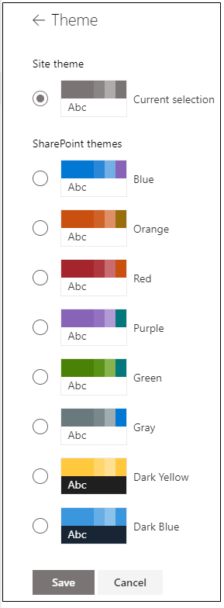
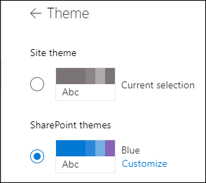
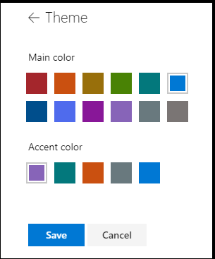
Apply style and branding to your site!
You can quickly and easily customize the look of your SharePoint site to reflect your professional style and brand. The options available to you depend on the version of SharePoint you're using.
Notes:
Change the look of your SharePoint site
You can quickly and easily customize the look of your SharePoint site to reflect your professional style and brand. The options available to you depend on the version of SharePoint you're using.
Note: To change the look, you need site owner or design permissions on the site.
Use a theme to change the colors of your SharePoint site
You can choose one of the default SharePoint themes and customize it as needed, choose a company theme with approved branding for your company, or use one of the classic experience designs. To create and upload a company theme, see SharePoint site theming.
Notes:
Some functionality is introduced gradually to organizations that have opted in to the Targeted Release program. This means that you may not yet see this feature or it may look different than what is described in the help articles.
For additional ways to customize your site, see Customize your SharePoint site.
On your site, click Settings and then click Change the look > Theme.
Note: If you don’t see Change the look on the Settings menu, you may not have permission to manage this option. For more information, see Understanding permission levels in SharePoint or ask your administrator.
Select the look you want. You'll see a preview of what your site looks like with the selected theme applied. Click Save to apply it to your site or, if you don't like what you see and want to revert back to what you had in the beginning, click Cancel instead.
Notes:
Your administrator may have set site theming to show only a list of company-approved themes. If so, you won't see any of the default SharePoint themes.
If you're updating the theme on a subsite or your administrator has sites set to the classic experience, follow the instructions in the Classic experience designs section .
To customize the colors of one of the default SharePoint themes, select the theme and then click Customize.
Choose the main color and accent color you want, and then click Save to apply it to your site. You can also select whether or not a grey (Neutral), light (Soft) or dark (Strong) version of the main color is applied to the header of your site or you can keep the default white header background. The list of main colors and accent colors varies depending on the default SharePoint theme you choose to customize.
Note: Currently, you can't change the background color for your site using this setting. SharePoint administrators can make changes to company-approved themes as described in SharePoint theming.
Change the color, background, or font with classic experience themes
If your administrator has sites set to the classic experience, or you're changing the theme of a subsite, follow these steps to change the color, background, and font of your SharePoint site:
On your site, click Settings and then click Change the look.
Click View classic settings or Classic change the look options. If you're already in the classic experience, skip this step.
Choose a look from among the choices. Don’t worry if you don’t like the color or the image exactly, you can change that in the next step.
To add or change the background image, click Change to upload an image of your own, or drag an image from your computer onto the thumbnail image above the Change command.
To change the color scheme, click the arrow next to Colors and select another color scheme.
To change the layout, click the arrow next to Site layout and select another layout, which controls the position of the navigation links, search box, and so on.
To change the fonts, click the arrow next to Fonts and select another font.
Note: You can change the font type style, but you can't change the size.
When you’re ready to see a full-sized preview of how your changes look when applied to your site content, click Try it out. The changes are not yet visible to other site users.
Note: If you don't like what you see and want to revert back to what you had in the beginning, click Start over or you can click your site logo to exit Change the look and go back to the home page of your site.
If you like what you see in the preview, click Yes, keep it. If not, click No, not quite there and try something else.

Slide 11
Administering site settings
Change a site's title, description, logo, and site information settings
Enable or disable site collection features
Walk through Site Settings

Slide 12
What is Web Parts
Out of Box Webparts
Divider
Document library
Embed
Events
File viewer
Hero
Highlighted content
Image
Image gallery
List
My feed
News
Organization chart
People
Quick chart
Quick links
Site activity
Spacer
Stream (classic)
Text
Weather
Yammer
Out of box Web Parts
Add a web part
Move or remove a web part
Available web parts
Web parts you can connect
Web part maintenance mode

Slide 13
SharePoint Designer
There will not be a new SharePoint Designer client shipped with this release. Microsoft will ensure that SharePoint Designer 2013 will work with SharePoint Server 2019 for the remainder of the client support lifecycle (2026). SharePoint Designer 2013 will not be supported beyond that timeframe.
SharePoint Designer 2013
https://www.microsoft.com/en-us/download/details.aspx?id=35491
Service Pack 1 for Microsoft SharePoint Designer 2013 (KB2817441) 32-Bit Edition
https://www.microsoft.com/en-us/download/details.aspx?id=42015
Notes:
SharePoint Designer 2013 is the tool of choice for the rapid development of SharePoint applications. Please make sure your installation of SharePoint Designer is up to date by using Microsoft Update, or installing Service Pack 1

